Slide 1

Extracting Online Data through Web Scraping in Python

Slide 2
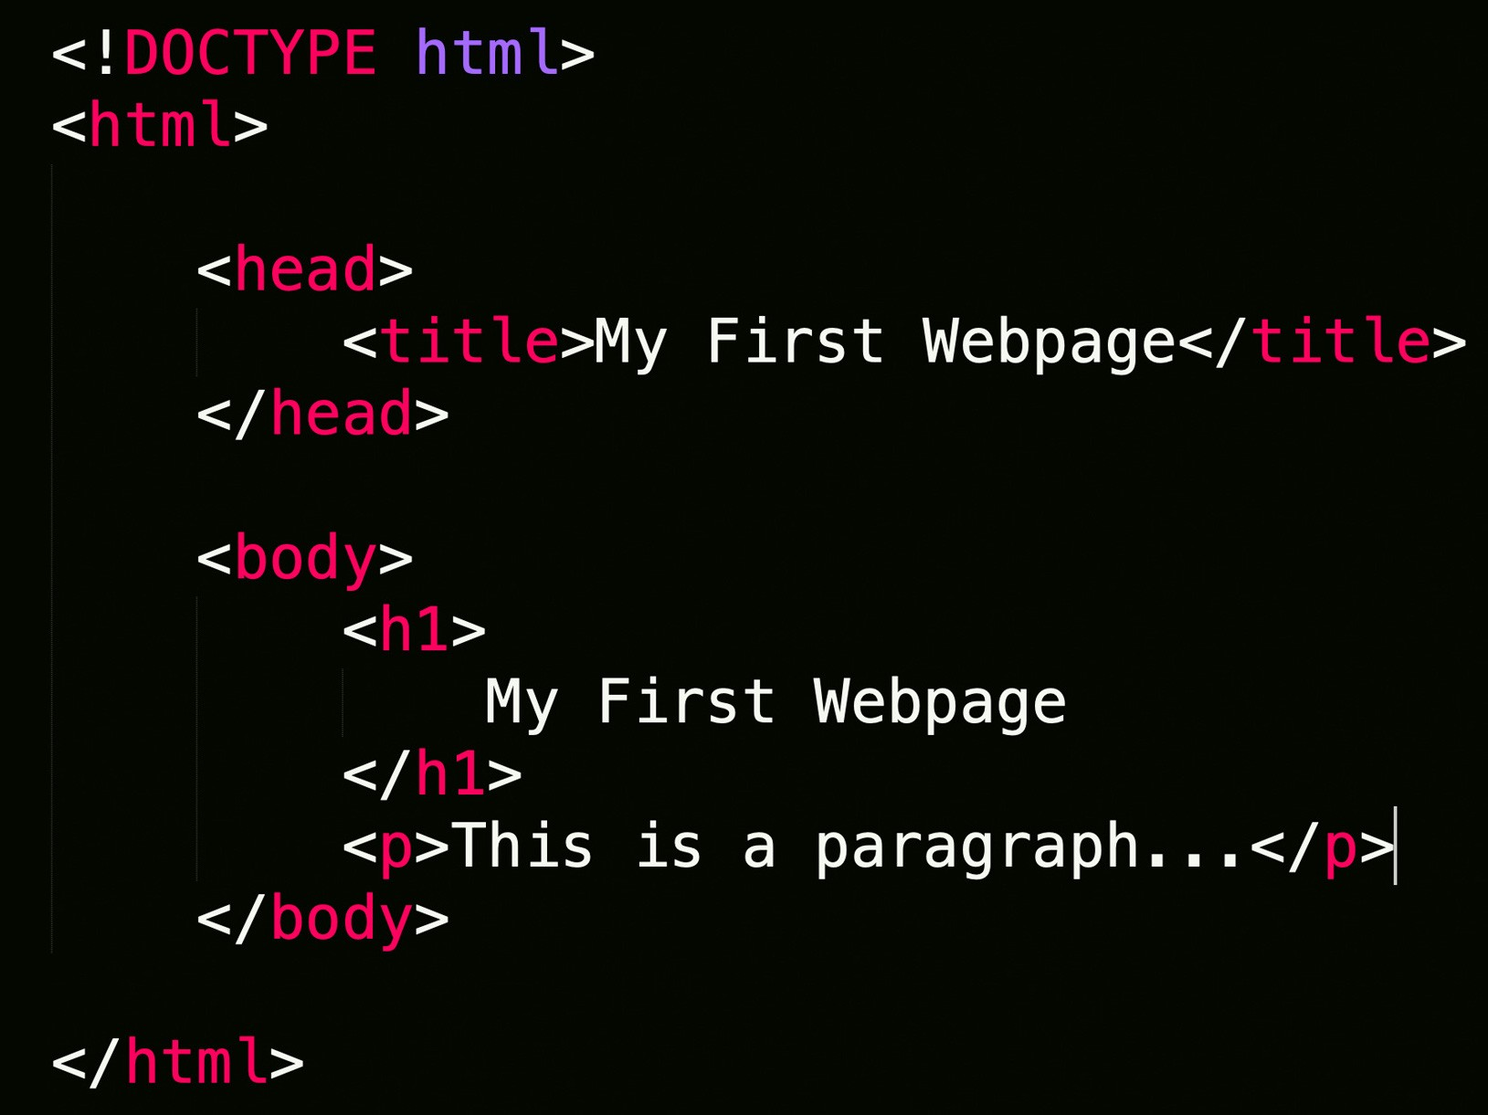
Web Scraping
Extraction of data from a website.
Loads HTML code from URL. User selects which content to keep

Slide 3


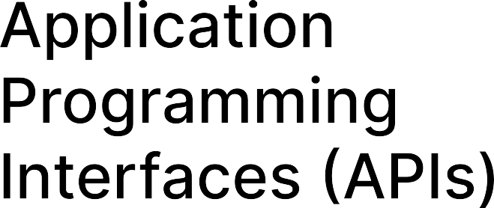
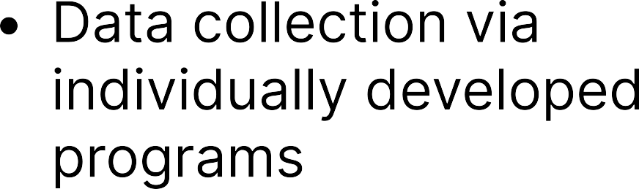

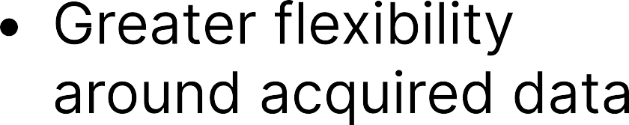




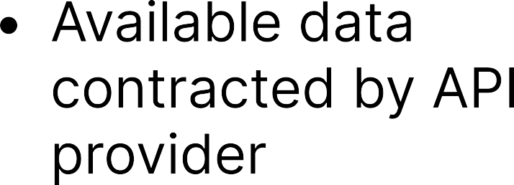
Web Scraping VS APIS

Slide 4







Slide 5
Coding Demo
Github Page
Smple code using beautifulSoup, Selenium
Travelocity Reviews
Filling out Form Example

Slide 6
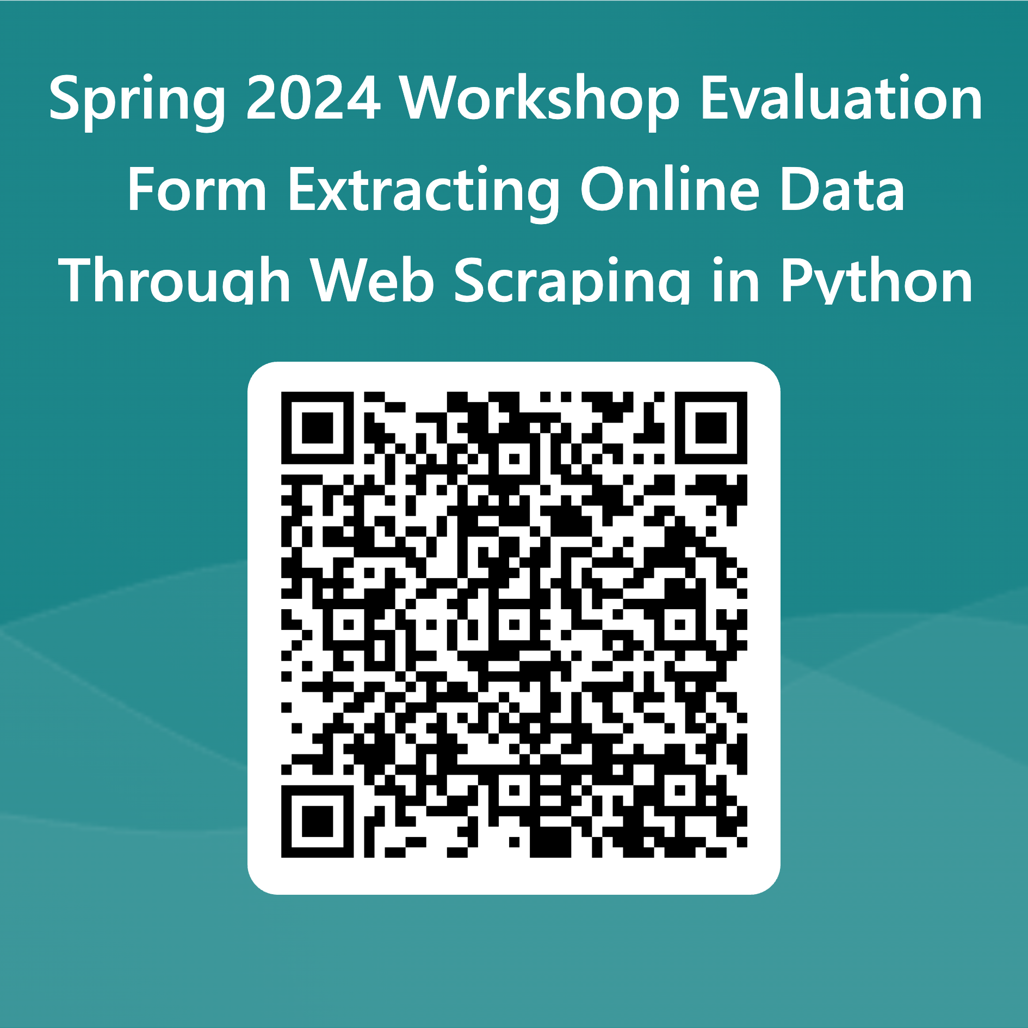
Evaluation

Slide 7
Other CCSS Resources
Programming/Coding Consultation, Data Consultation. For 1v1 or group trainings. Qualitative, Quantitative, Accessing and working with Data. (Python, R, Stata most popular)
CCSS Workshops. Recordings upon request. Email socialsciences@cornell.edu
Data Discovery and Replication

